Slide 1

Chapter 3
Classical Symmetric-Key Ciphers

Slide 2
Outlines
Classical Substitution Ciphers.
Classical Transposition / Permutation Ciphers.
Product Ciphers.

Slide 3
Learning Objectives
In the end of this Chapter 3, students should be able:
To understand and implement classical substitution techniques, including monoalphabetic and polyalphabetic substitution ciphers to encrypt a message.
To understand and implement classical transposition or permutation techniques, including key and keyless transposition ciphers to encrypt a message.
To understand the concept of product cipher in encryption.
To understand and perform cryptanalysis to the above classical techniques in different perspectives.

Slide 4
Classical Symmetric-Key Ciphers (Overview)
The classical (or traditional) symmetric-key ciphers can be divided into two broad categories:
Substitution ciphers.
It replaces one symbol with another symbol.
It can be categorized further into monoalphabetic and polyalphabetic ciphers.
Transposition / Permutation ciphers.
It changes or reorder the position of the symbols.
It can be done either keyless, or with a key.

Slide 5
SUBSTITUTION CIPHERS

Slide 6
Substitution Cipher – Overview
A technique that replaces the letters in plaintext by other letters / numbers / symbols.
If the plaintext is viewed as a sequence of bits, then it involves replacing the plaintext bit patterns with ciphertext bit patterns.
Substitution technique can be further divided into two categories:
Monoalphabetic cipher.
Polyalphabetic cipher.

Slide 7
MONOALPHABETIC SUBSTITUTION CIPHERS

Slide 8
Monoalphabetic Substitution Cipher
Monoalphabetic Cipher:
It replaces one letter in the plaintext by another letter.
The replacement is a ONE-TO-ONE relation. That is, the same letter is replaced by the same other letter (unique) regardless of its position in the plaintext.
Three major monoalphabetic cipher techniques:
Shift (Additive) Cipher
Multiplicative Cipher
Affine Cipher

Slide 9
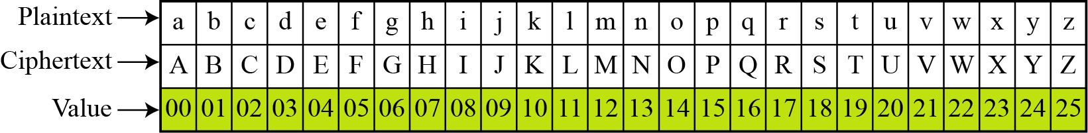

Monoalphabetic Substitution – Shift Cipher
A technique of shifting a key, $k$ character by certain position (either up or down).
Since it involves the shift of alphabets (A – Z), there are $26$ alphabets available. We can view it as a group of $ℤ_{26}$, in which we assign each letter to an integer.
It is also known as additive cipher.

Slide 10

Monoalphabetic Substitution – Shift Cipher
This form an additive cipher model with a modular of $26$, or $\left(mod 26\right)$.

Slide 11
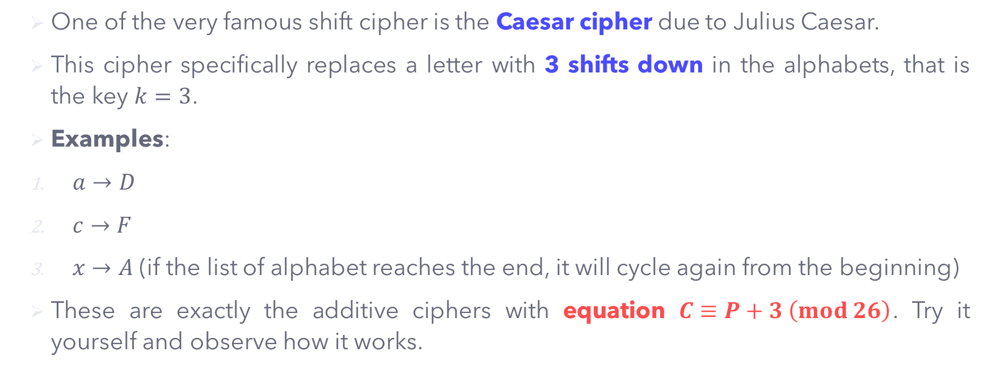
Monoalphabetic Substitution – Shift Cipher
One of the very famous shift cipher is the Caesar cipher due to Julius Caesar.
This cipher specifically replaces a letter with 3 shifts down in the alphabets, that is the key $k=3$.
Examples:
$a→D$
$c→F$
$x→A$ (if the list of alphabet reaches the end, it will cycle again from the beginning)
These are exactly the additive ciphers with equation $C≡P+3 \left(mod 26\right)$. Try it yourself and observe how it works.

Slide 12
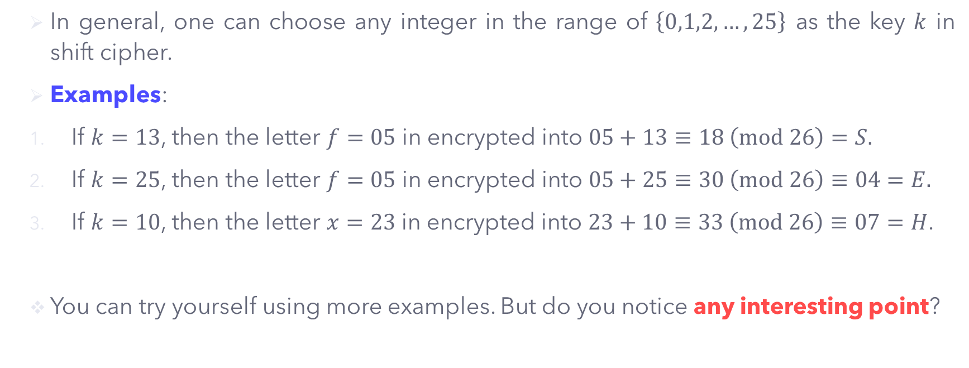
Monoalphabetic Substitution – Shift Cipher
In general, one can choose any integer in the range of $\left\{0,1,2,…,25\right\}$ as the key $k$ in shift cipher.
Examples:
If $k=13$, then the letter $f=05$ in encrypted into $05+13≡18 \left(mod 26\right)=S.$
If $k=25$, then the letter $f=05$ in encrypted into $05+25≡30 \left(mod 26\right)≡04=E.$
If $k=10$, then the letter $x=23$ in encrypted into $23+10≡33 \left(mod 26\right)≡07=H$.
You can try yourself using more examples. But do you notice any interesting point?

Slide 13
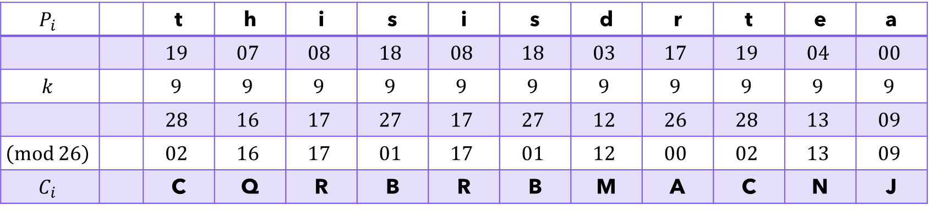

Monoalphabetic Substitution – Shift Cipher
Example 1: Encrypt the message ‘this is dr tea’ using a shift cipher with key $k=9$.
Solution: The encryption equation is given by $C≡P+9 \left(mod 26\right)$
The ciphertext produced is: CQRBRBMACNJ.
$$P_{i}$$ |  | t | h | i | s | i | s | d | r | t | e | a
 |  | $$19$$ | $$07$$ | $$08$$ | $$18$$ | $$08$$ | $$18$$ | $$03$$ | $$17$$ | $$19$$ | $$04$$ | $$00$$
$$k$$ |  | $$9$$ | $$9$$ | $$9$$ | $$9$$ | $$9$$ | $$9$$ | $$9$$ | $$9$$ | $$9$$ | $$9$$ | $$9$$
 |  | $$28$$ | $$16$$ | $$17$$ | $$27$$ | $$17$$ | $$27$$ | $$12$$ | $$26$$ | $$28$$ | $$13$$ | $$09$$
$$\left(mod 26\right)$$ |  | $$02$$ | $$16$$ | $$17$$ | $$01$$ | $$17$$ | $$01$$ | $$12$$ | $$00$$ | $$02$$ | $$13$$ | $$09$$
$$C_{i}$$ |  | C | Q | R | B | R | B | M | A | C | N | J

Slide 14
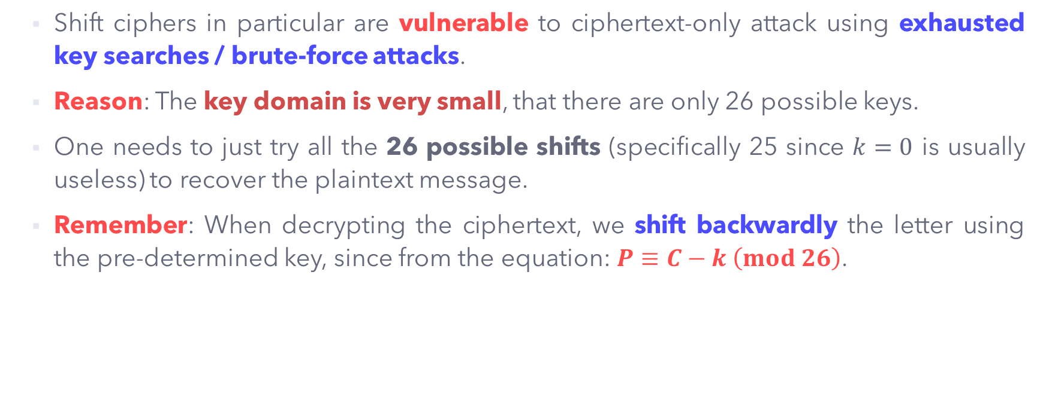
Cryptanalysis on Shift Cipher
Shift ciphers in particular are vulnerable to ciphertext-only attack using exhausted key searches / brute-force attacks.
Reason: The key domain is very small, that there are only 26 possible keys.
One needs to just try all the 26 possible shifts (specifically 25 since $k=0$ is usually useless) to recover the plaintext message.
Remember: When decrypting the ciphertext, we shift backwardly the letter using the pre-determined key, since from the equation: $P≡C−k \left(mod 26\right)$.

Slide 15
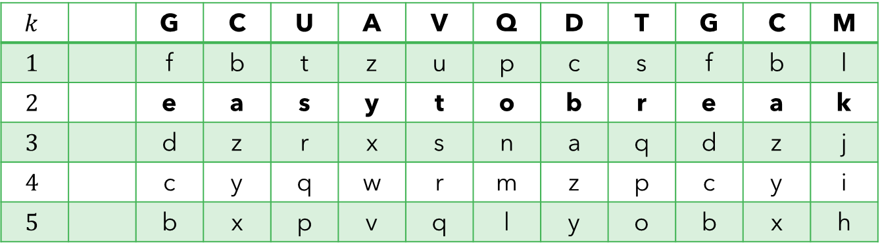
Cryptanalysis on Shift Cipher
Example 2: Perform brute-force attack on the ciphertext ‘GCUAVQDTGCM’
The recovered plaintext is: easy to break.
$$k$$ |  | G | C | U | A | V | Q | D | T | G | C | M
$$1$$ |  | f | b | t | z | u | p | c | s | f | b | l
$$2$$ |  | e | a | s | y | t | o | b | r | e | a | k
$$3$$ |  | d | z | r | x | s | n | a | q | d | z | j
$$4$$ |  | c | y | q | w | r | m | z | p | c | y | i
$$5$$ |  | b | x | p | v | q | l | y | o | b | x | h
This gives a meaningful plaintext.

Slide 16
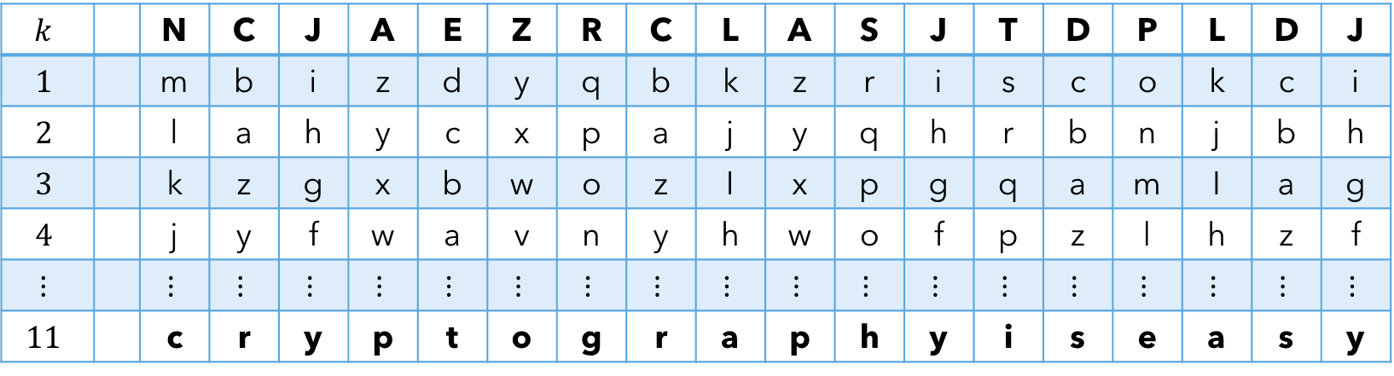
Cryptanalysis on Shift Cipher
Exercise 1: Perform cryptanalysis on the ciphertext ‘NCJAEZRCLASJTDPLDJ‘.
The recovered plaintext is: cryptography is easy.
$$k$$ |  | N | C | J | A | E | Z | R | C | L | A | S | J | T | D | P | L | D | J
$$1$$ |  | m | b | i | z | d | y | q | b | k | z | r | i | s | c | o | k | c | i
$$2$$ |  | l | a | h | y | c | x | p | a | j | y | q | h | r | b | n | j | b | h
$$3$$ |  | k | z | g | x | b | w | o | z | I | x | p | g | q | a | m | I | a | g
$$4$$ |  | j | y | f | w | a | v | n | y | h | w | o | f | p | z | l | h | z | f
$$⋮$$ |  | $$⋮$$ | $$⋮$$ | $$⋮$$ | $$⋮$$ | $$⋮$$ | $$⋮$$ | $$⋮$$ | $$⋮$$ | $$⋮$$ | $$⋮$$ | $$⋮$$ | $$⋮$$ | $$⋮$$ | $$⋮$$ | $$⋮$$ | $$⋮$$ | $$⋮$$ | $$⋮$$
$$11$$ |  | c | r | y | p | t | o | g | r | a | p | h | y | i | s | e | a | s | y

Slide 17
Cryptanalysis on Shift Cipher
In short, brute-force cryptanalysis is easy in shift cipher due to the following important characteristics:
The encryption and decryption algorithms are known.
There are only 25 keys to try.
The language of the plaintext is known and easily recognizable.

Slide 18

Monoalphabetic Substitution – Multiplicative Cipher
In multiplicative cipher, the encryption algorithm specifies the multiplication of the plaintext by the key $k$, and the decryption algorithm specifies the division of the ciphertext by the inverse of the key, $k^{−1}$.

Slide 19
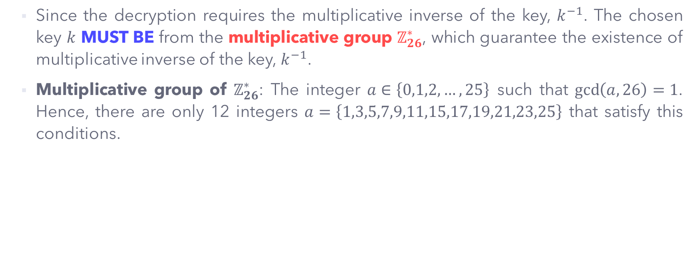
Monoalphabetic Substitution – Multiplicative Cipher
Since the decryption requires the multiplicative inverse of the key, $k^{−1}$. The chosen key $k$ MUST BE from the multiplicative group $ℤ_{26}^{∗}$, which guarantee the existence of multiplicative inverse of the key, $k^{−1}$.
Multiplicative group of $ℤ_{26}^{∗}$: The integer $a∈\left\{0,1,2,…,25\right\}$ such that $\gcd\left(a,26\right)=1$. Hence, there are only 12 integers $a=\left\{1,3,5,7,9,11,15,17,19,21,23,25\right\}$ that satisfy this conditions.

Slide 20
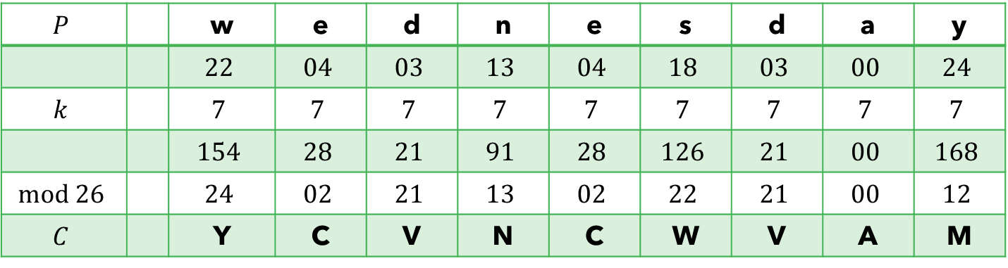

Monoalphabetic Substitution – Multiplicative Cipher
Example 3: Encrypt the message ‘wednesday’ using multiplicative cipher with key $k=7$.
Solution: The encryption equation is given by $C≡P×k \left(mod 26\right)$.
The ciphertext produced is: YCVN CWVA M.
$$P$$ |  | w | e | d | n | e | s | d | a | y
 |  | $$22$$ | $$04$$ | $$03$$ | $$13$$ | $$04$$ | $$18$$ | $$03$$ | $$00$$ | $$24$$
$$k$$ |  | $$7$$ | $$7$$ | $$7$$ | $$7$$ | $$7$$ | $$7$$ | $$7$$ | $$7$$ | $$7$$
 |  | $$154$$ | $$28$$ | $$21$$ | $$91$$ | $$28$$ | $$126$$ | $$21$$ | $$00$$ | $$168$$
$$mod 26$$ |  | $$24$$ | $$02$$ | $$21$$ | $$13$$ | $$02$$ | $$22$$ | $$21$$ | $$00$$ | $$12$$
$$C$$ |  | Y | C | V | N | C | W | V | A | M

Slide 21
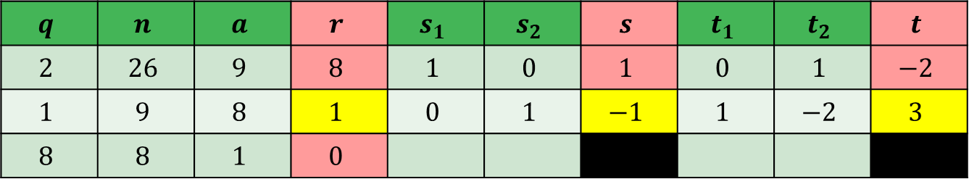
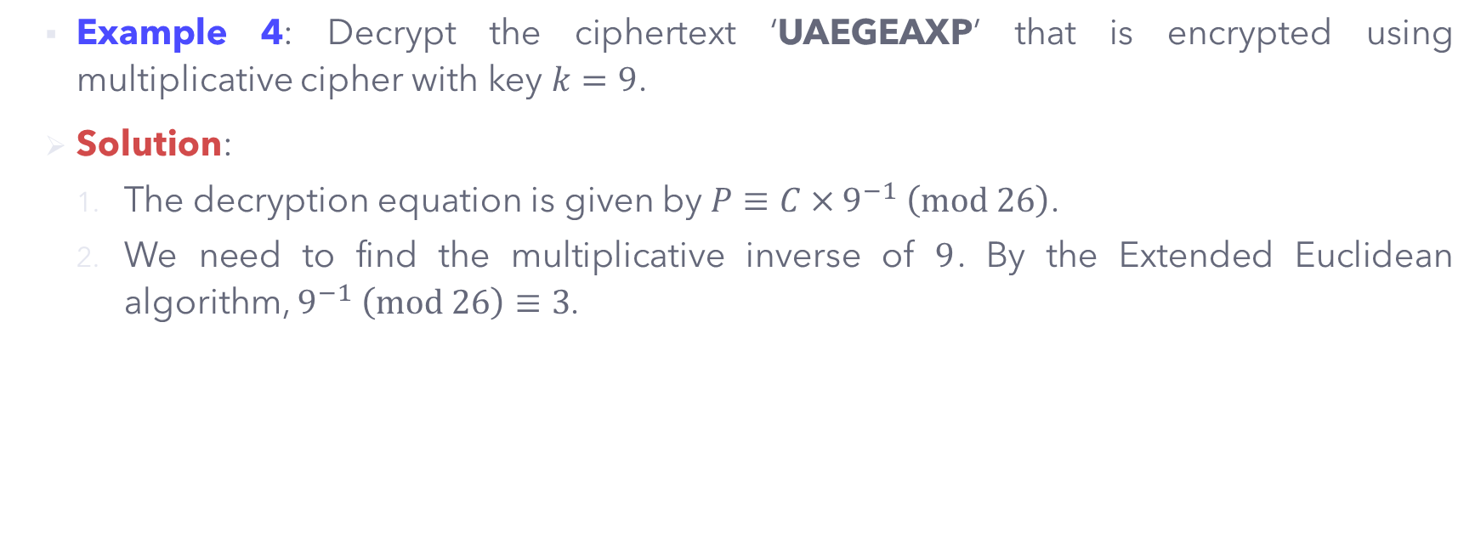
Monoalphabetic Substitution – Multiplicative Cipher
Example 4: Decrypt the ciphertext ‘UAEGEAXP’ that is encrypted using multiplicative cipher with key $k=9$.
Solution:
The decryption equation is given by $P≡C×9^{−1} \left(mod 26\right)$.
We need to find the multiplicative inverse of $9$. By the Extended Euclidean algorithm, $9^{−1} \left(mod 26\right)≡3$.
$$q$$ | $$n$$ | $$a$$ | $$r$$ | $$s_{1}$$ | $$s_{2}$$ | $$s$$ | $$t_{1}$$ | $$t_{2}$$ | $$t$$
$$2$$ | $$26$$ | $$9$$ | $$8$$ | $$1$$ | $$0$$ | $$1$$ | $$0$$ | $$1$$ | $$−2$$
$$1$$ | $$9$$ | $$8$$ | $$1$$ | $$0$$ | $$1$$ | $$−1$$ | $$1$$ | $$−2$$ | $$3$$
$$8$$ | $$8$$ | $$1$$ | $$0$$

Slide 22
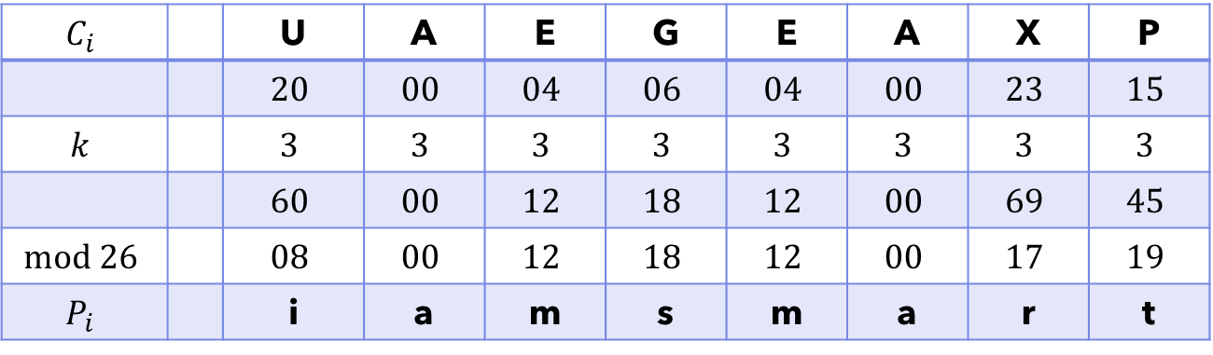

Monoalphabetic Substitution – Multiplicative Cipher
Hence, the decryption equation is $P≡C×3 \left(mod 26\right)$.
The recovered plaintext is: I am smart.
$$C_{i}$$ |  | U | A | E | G | E | A | X | P
 |  | $$20$$ | $$00$$ | $$04$$ | $$06$$ | $$04$$ | $$00$$ | $$23$$ | $$15$$
$$k$$ |  | $$3$$ | $$3$$ | $$3$$ | $$3$$ | $$3$$ | $$3$$ | $$3$$ | $$3$$
 |  | $$60$$ | $$00$$ | $$12$$ | $$18$$ | $$12$$ | $$00$$ | $$69$$ | $$45$$
$$mod 26$$ |  | $$08$$ | $$00$$ | $$12$$ | $$18$$ | $$12$$ | $$00$$ | $$17$$ | $$19$$
$$P_{i}$$ |  | i | a | m | s | m | a | r | t

Slide 23

Monoalphabetic Substitution – Affine Cipher
The combination of both additive and multiplicative cipher techniques using a pair of keys $\left(k_{1},k_{2}\right)$.
The plaintext is first encrypted using multiplicative cipher with key $k_{1}$, and next encrypted further using additive cipher with key $k_{2}$.

Slide 24
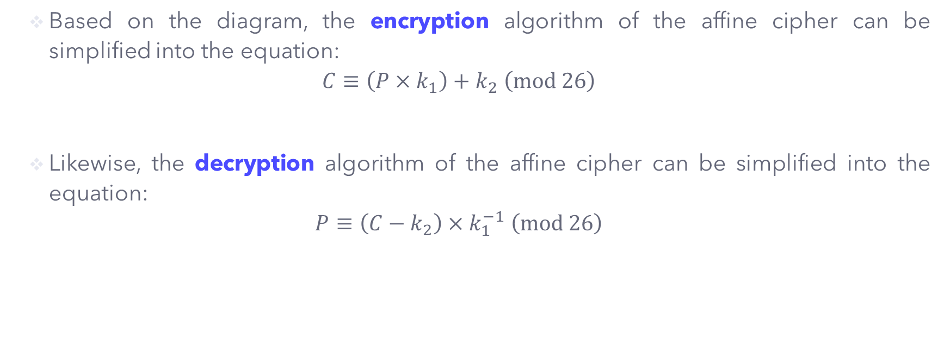
Monoalphabetic Substitution – Affine Cipher
Based on the diagram, the encryption algorithm of the affine cipher can be simplified into the equation:
$$C≡\left(P×k_{1}\right)+k_{2} \left(mod 26\right)$$
Likewise, the decryption algorithm of the affine cipher can be simplified into the equation:
$$P≡\left(C−k_{2}\right)×k_{1}^{−1} \left(mod 26\right)$$

Slide 25
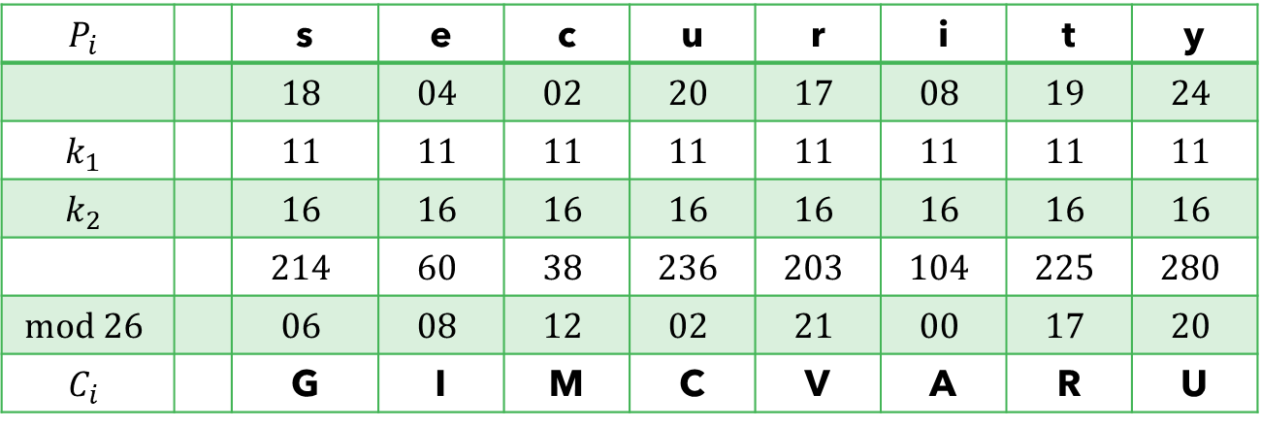

Monoalphabetic Substitution – Affine Cipher
Example 5: Encrypt the message ‘security’ using affine cipher with the key pair $\left(11,16\right)$.
Solution: The encryption equation is given by $C≡\left(P×11\right)+16 \left(mod 26\right)$.
The ciphertext produced is: GIMC VARU.
$$P_{i}$$ |  | s | e | c | u | r | i | t | y
 |  | $$18$$ | $$04$$ | $$02$$ | $$20$$ | $$17$$ | $$08$$ | $$19$$ | $$24$$
$$k_{1}$$ |  | $$11$$ | $$11$$ | $$11$$ | $$11$$ | $$11$$ | $$11$$ | $$11$$ | $$11$$
$$k_{2}$$ |  | $$16$$ | $$16$$ | $$16$$ | $$16$$ | $$16$$ | $$16$$ | $$16$$ | $$16$$
 |  | $$214$$ | $$60$$ | $$38$$ | $$236$$ | $$203$$ | $$104$$ | $$225$$ | $$280$$
$$mod 26$$ |  | $$06$$ | $$08$$ | $$12$$ | $$02$$ | $$21$$ | $$00$$ | $$17$$ | $$20$$
$$C_{i}$$ |  | G | I | M | C | V | A | R | U

Slide 26
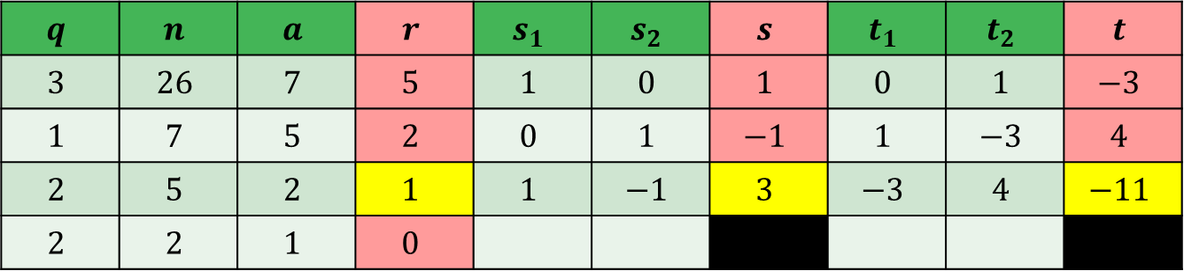
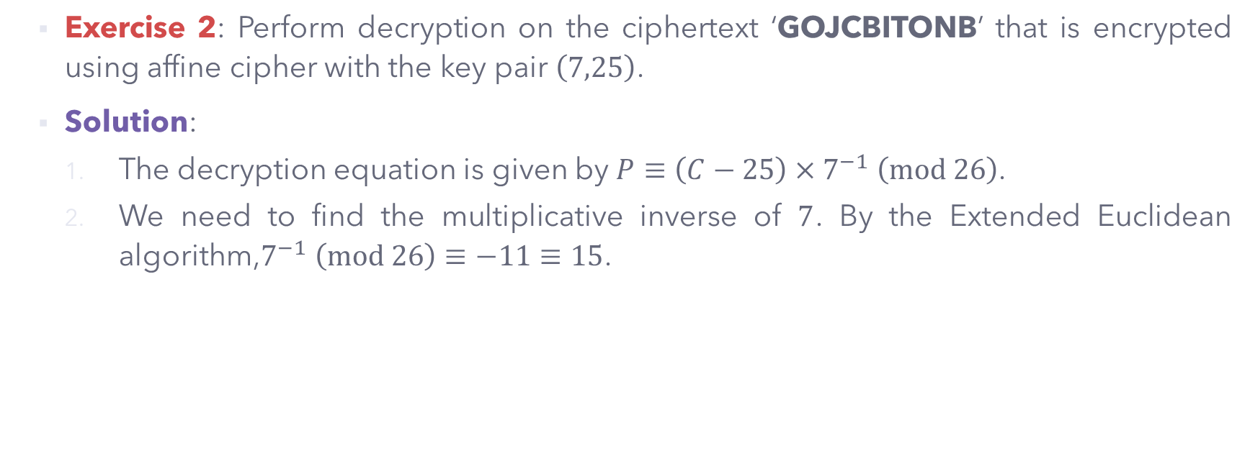
Monoalphabetic Substitution – Affine Cipher
Exercise 2: Perform decryption on the ciphertext ‘GOJCBITONB’ that is encrypted using affine cipher with the key pair $\left(7,25\right)$.
Solution:
The decryption equation is given by $P≡\left(C−25\right)×7^{−1} \left(mod 26\right)$.
We need to find the multiplicative inverse of $7$. By the Extended Euclidean algorithm,$7^{−1} \left(mod 26\right)≡−11≡15$.
$$q$$ | $$n$$ | $$a$$ | $$r$$ | $$s_{1}$$ | $$s_{2}$$ | $$s$$ | $$t_{1}$$ | $$t_{2}$$ | $$t$$
$$3$$ | $$26$$ | $$7$$ | $$5$$ | $$1$$ | $$0$$ | $$1$$ | $$0$$ | $$1$$ | $$−3$$
$$1$$ | $$7$$ | $$5$$ | $$2$$ | $$0$$ | $$1$$ | $$−1$$ | $$1$$ | $$−3$$ | $$4$$
$$2$$ | $$5$$ | $$2$$ | $$1$$ | $$1$$ | $$−1$$ | $$3$$ | $$−3$$ | $$4$$ | $$−11$$
$$2$$ | $$2$$ | $$1$$ | $$0$$

Slide 27
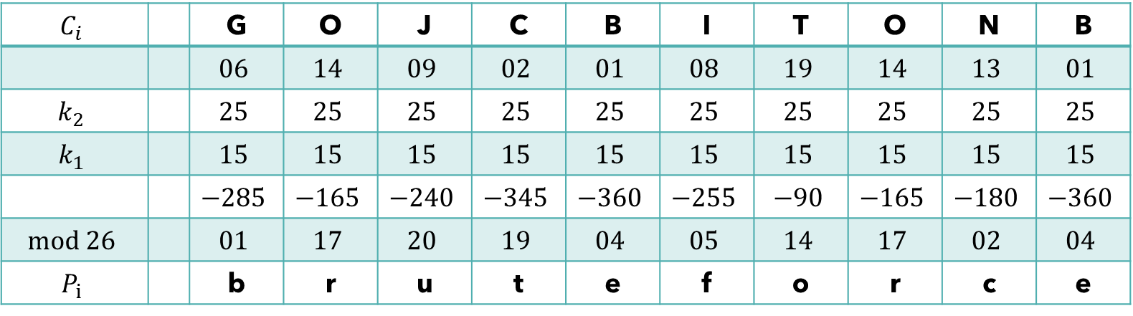

Monoalphabetic Substitution – Affine Cipher
Hence, the decryption equation is $P≡\left(C−25\right)×15 \left(mod 26\right)$.
The recovered plaintext is: brute force.
$$C_{i}$$ |  | G | O | J | C | B | I | T | O | N | B
 |  | $$06$$ | $$14$$ | $$09$$ | $$02$$ | $$01$$ | $$08$$ | $$19$$ | $$14$$ | $$13$$ | $$01$$
$$k_{2}$$ |  | $$25$$ | $$25$$ | $$25$$ | $$25$$ | $$25$$ | $$25$$ | $$25$$ | $$25$$ | $$25$$ | $$25$$
$$k_{1}$$ |  | $$15$$ | $$15$$ | $$15$$ | $$15$$ | $$15$$ | $$15$$ | $$15$$ | $$15$$ | $$15$$ | $$15$$
 |  | $$−285$$ | $$−165$$ | $$−240$$ | $$−345$$ | $$−360$$ | $$−255$$ | $$−90$$ | $$−165$$ | $$−180$$ | $$−360$$
$$mod 26$$ |  | $$01$$ | $$17$$ | $$20$$ | $$19$$ | $$04$$ | $$05$$ | $$14$$ | $$17$$ | $$02$$ | $$04$$
$$P_{i}$$ |  | b | r | u | t | e | f | o | r | c | e

Slide 28
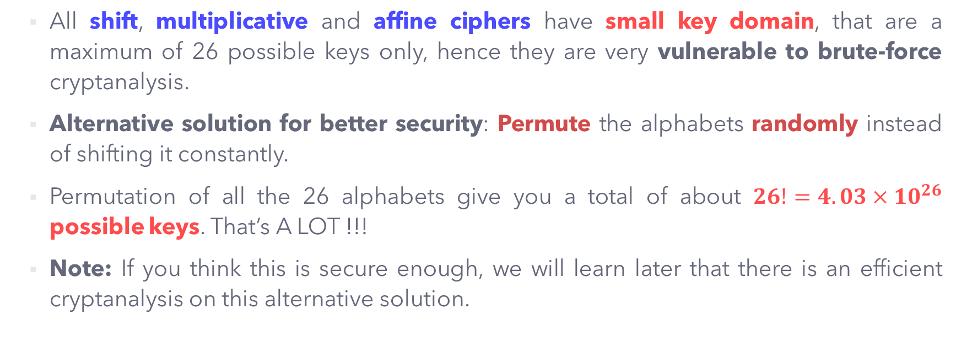
Monoalphabetic Substitution – Security Issues
All shift, multiplicative and affine ciphers have small key domain, that are a maximum of 26 possible keys only, hence they are very vulnerable to brute-force cryptanalysis.
Alternative solution for better security: Permute the alphabets randomly instead of shifting it constantly.
Permutation of all the 26 alphabets give you a total of about $26!=4.03×{10}^{26}$ possible keys. That’s A LOT !!!
Note: If you think this is secure enough, we will learn later that there is an efficient cryptanalysis on this alternative solution.

Slide 29
Monoalphabetic Substitution – Security Issues
Example 6: Suppose now Alice and Bob agreed on the randomized alphabets between plaintext and ciphertext, as follows.
To encrypt a message ‘hello Bob’, the produced ciphertext is now ‘CRDDYOYO’.
Note: There is no specific key to shift any of these alphabetic, it seems more secure, right?

Slide 30
Monoalphabetic Substitution – Frequency Analysis
Besides brute-force attack, the most common cryptanalysis on substitution cipher is the statistical attack known as the FREQUENCY ANALYSIS.
Assuming that common plaintext-ciphertext are written in English, and an attacker is well familiar with the nature of such a language, the frequency of occurrence of an English letter can be predicted efficiently.
For example, the letter ‘E’ always appear with the HIGHEST frequency in an English text.

Slide 31
Monoalphabetic Substitution – Frequency Analysis
The table below shows the overall frequency of occurrence of letters in an English text in general.

Slide 32
Monoalphabetic Substitution – Frequency Analysis
Besides a single letter, English words often comes in some specific letter combinations, either two-letter (bigrams) group, or three-letter (trigrams) group.
Examples of bigrams: THe, THree, THey, THem, etc.
Examples of trigrams: THE, THEme, THEy, THEir, THEm, etc.
The table below shows the groups of common bigrams and trigrams in English texts.

Slide 33
Monoalphabetic Substitution – Frequency Analysis
The technique of frequency analysis:
Count the relative frequencies of letters, and the resulting pattern in the ciphertext.
Compare the relative frequencies to the standard frequency distribution for English.
Search for the frequency of bigrams and trigrams.
Combine the results to identify the meaningful words.
Repeat the analysis of frequencies with trial and error to find a possible solution for other letters.

Slide 34
Monoalphabetic Substitution – Frequency Analysis
Why is frequency analysis effective on monoalphabetic substitution cipher?
Reason: Monoalphabetic substitution does not change the relative frequency of the letters, be it in plaintext or ciphertext.
This elegant method is introduced by Al-Kindi, an Arabic scientist in 9th century.
Mentioned in his book entitled ‘Manuscript on Deciphering Cryptographic Messages’ that gave rise to the birth of cryptanalysis.

Slide 35
Monoalphabetic Substitution – Frequency Analysis
Exercise 1: Try to use frequency analysis to break this ciphertext (It may take some time at the beginning).

Slide 36
POLYALPHABETIC SUBSTITUTION CIPHERS

Slide 37
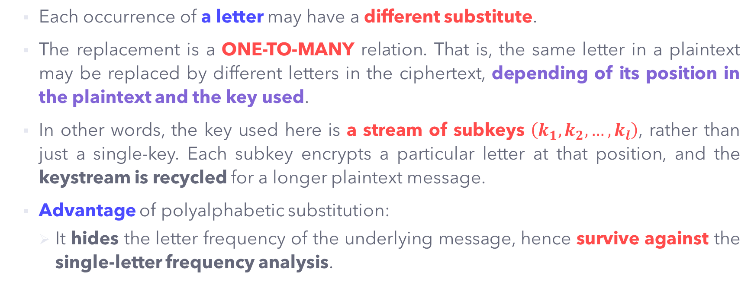
Polyalphabetic Substitution Cipher
Each occurrence of a letter may have a different substitute.
The replacement is a ONE-TO-MANY relation. That is, the same letter in a plaintext may be replaced by different letters in the ciphertext, depending of its position in the plaintext and the key used.
In other words, the key used here is a stream of subkeys $\left(k_{1},k_{2},…,k_{l}\right)$, rather than just a single-key. Each subkey encrypts a particular letter at that position, and the keystream is recycled for a longer plaintext message.
Advantage of polyalphabetic substitution:
It hides the letter frequency of the underlying message, hence survive against the single-letter frequency analysis.

Slide 38
Polyalphabetic Substitution Cipher
Some common polyalphabetic cipher techniques:
Autokey Cipher
Playfair Cipher
Vigenère Cipher
Rotor Cipher and the Enigma Machine
Vernam Cipher and the One-Time Pad
Hill Cipher (Optional)

Slide 39
Polyalphabetic Substitution – Autokey Cipher
A simple polyalphabetic substitution cipher.
The key is a stream of subkeys used to encrypt the corresponding character in the plaintext:
The first subkey is a pre-determined secret value.
The subsequent subkeys are the characters from the plaintext (in order).
Autokey: The subkeys are automatically created from the plaintext characters during the encryption process.

Slide 40
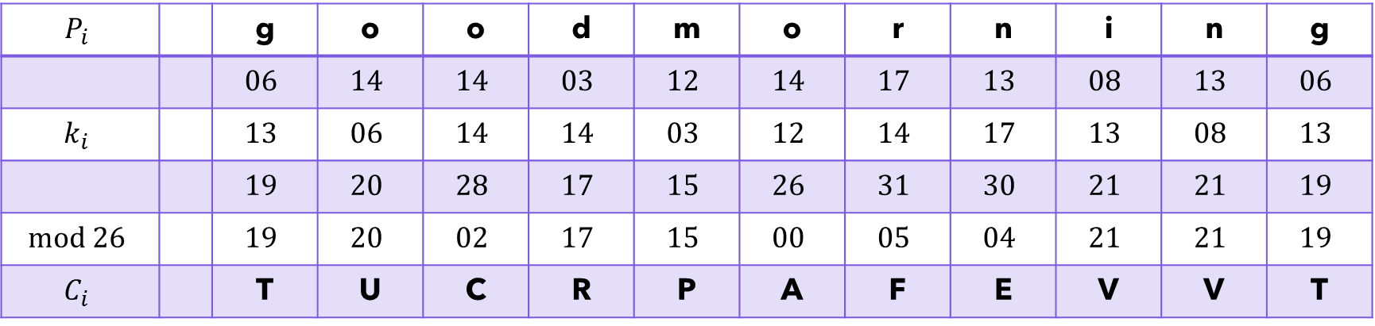

Polyalphabetic Substitution – Autokey Cipher
Example 7: Using the initial subkey $k_{1}=13$, encrypt the message ‘Good morning’ using autokey cipher.
The ciphertext produced is: TUCR PAFE VVT.
$$P_{i}$$ |  | g | o | o | d | m | o | r | n | i | n | g
 |  | $$06$$ | $$14$$ | $$14$$ | $$03$$ | $$12$$ | $$14$$ | $$17$$ | $$13$$ | $$08$$ | $$13$$ | $$06$$
$$k_{i}$$ |  | $$13$$ | $$06$$ | $$14$$ | $$14$$ | $$03$$ | $$12$$ | $$14$$ | $$17$$ | $$13$$ | $$08$$ | $$13$$
 |  | $$19$$ | $$20$$ | $$28$$ | $$17$$ | $$15$$ | $$26$$ | $$31$$ | $$30$$ | $$21$$ | $$21$$ | $$19$$
$$mod 26$$ |  | $$19$$ | $$20$$ | $$02$$ | $$17$$ | $$15$$ | $$00$$ | $$05$$ | $$04$$ | $$21$$ | $$21$$ | $$19$$
$$C_{i}$$ |  | T | U | C | R | P | A | F | E | V | V | T

Slide 41
Polyalphabetic Substitution – Autokey Cipher
Observations from Example 7:
The character ‘o’ is encrypted into two different ciphertext characters of ‘U’ and ‘C’.
The ciphertext character ‘V’ is an output of two different plaintext characters ‘i’ and ‘n’.
The same plaintext character ‘g’ is encrypted into the same ciphertext character ‘T’ due to coincident of the subkey streams and its position during encryption.

Slide 42
Security on Autokey Cipher
Advantage:
It hides the single-letter frequency analysis.
Disadvantage:
It is still vulnerable to brute-force attack since it is an additive cipher.
An attacker may just need to keep trying all the 25 possible pre-determined values to recover the first character, and then use it to analyse the subsequent ciphertext (since the subsequent subkeys are the plaintext characters).
Remedy: Use larger key domain.
Instead of a single pre-determined key, we may use multiple pre-determined key streams.

Slide 43

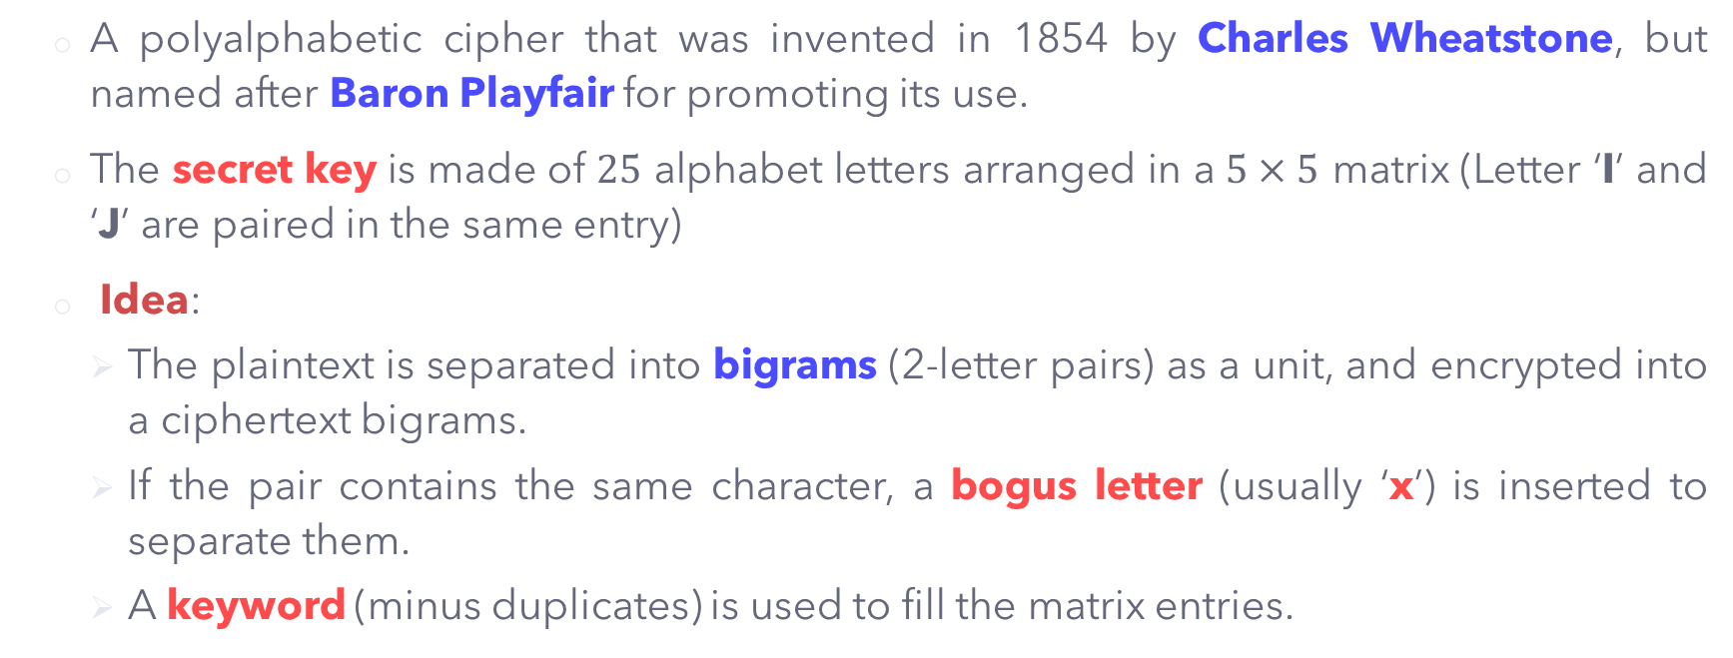
Polyalphabetic Substitution – Playfair Cipher
A polyalphabetic cipher that was invented in 1854 by Charles Wheatstone, but named after Baron Playfair for promoting its use.
The secret key is made of $25$ alphabet letters arranged in a $5×5$ matrix (Letter ‘I’ and ‘J’ are paired in the same entry)
Idea:
The plaintext is separated into bigrams (2-letter pairs) as a unit, and encrypted into a ciphertext bigrams.
If the pair contains the same character, a bogus letter (usually ‘x’) is inserted to separate them.
A keyword (minus duplicates) is used to fill the matrix entries.

Slide 44
Polyalphabetic Substitution – Playfair Cipher
Procedures/rules of Playfair cipher encryption:
Plaintext is split into bigrams, repeating letters that are in the same pair and last single letter are separated/padded with a bogus (usually ‘x’).
Two plaintext letters that fall in the same row of the matrix are each replaced by the letter to the RIGHT, with the 1st element of the row circularly following the last.
Two plaintext letters that fall in the same column of the matrix are each replaced by the letter BENEATH, with the top element of the column circularly following the last.
Otherwise, each plaintext letter in pair is replaced by the letter that lies in its own row and the column occupied by the other plaintext letter.

Slide 45
Polyalphabetic Substitution – Playfair Cipher
Example 8:Perform encryption on the message ‘parallel’ using Playfair cipher with the keyword ‘monday’.
Solution:
The plaintext is split into bigrams: pa ra lx le lx.
Fill the matrix with keyword first, then followed by the remaining letters in alphabetical order (see right).
Encrypt according the procedures/rules given.
M | O | N | D | A
Y | B | C | E | F
G | H | I/J | K | L
P | Q | R | S | T
U | V | W | X | Z

Slide 46
Polyalphabetic Substitution – Playfair Cipher
According to the matrix, the bigram ‘pa’ is encrypted into ‘TM’. ‘p’ slides to ‘T’ and ‘a’ slides to ‘M’ (you can view as they are sliding to the corner end of each row and column in the ‘box’).
The procedures are repeated for all the bigrams.
The produced ciphertext is: TMTN KZKF KZ.
Plaintext | Ciphertext
pa | TM
ra | TN
lx | KZ
le | KF
lx | KZ

Slide 47
Polyalphabetic Substitution – Playfair Cipher
Example 9: Perform encryption on the message ‘balloon’ using Playfair cipher with the keyword ‘monarchy’.
Solution:
The plaintext is split into bigrams: ba lx lo on.
Fill the matrix with keyword first, then followed by the remaining letters in alphabetical order (see right).
Encrypt according the procedures/rules given.
M | O | N | A | R
C | H | Y | B | D
E | F | G | I/J | K
L | P | Q | S | T
U | V | W | X | Z

Slide 48
Polyalphabetic Substitution – Playfair Cipher
According to the matrix, the bigram ‘ba’ is encrypted into ‘IB’ or ‘JB’ (whichever you prefer). ‘b’ drops to ‘I/J’ and ‘a’ drops to ‘B’.
The procedures are repeated for all the bigrams.
The produced ciphertext is: IB(JB)SU PMNA.
Plaintext | Ciphertext
ba | IB/JB
lx | SU
lo | PM
on | NA

Slide 49
Polyalphabetic Substitution – Playfair Cipher
Exercise 4: Perform encryption on the message ‘The class is cancelled today’ using Playfair cipher with the keyword ‘cryptography’.
Solution:
The plaintext is split into bigrams: th ec la sx si sc an ce lx le dt od ay.
The produced ciphertext is: PBDR NOQZ QKLT FWRD QUMD KCDL FA.
C | R | Y | P | T
O | G | A | H | B
D | E | F | I/J | K
L | M | N | Q | S
U | V | W | X | Z

Slide 50
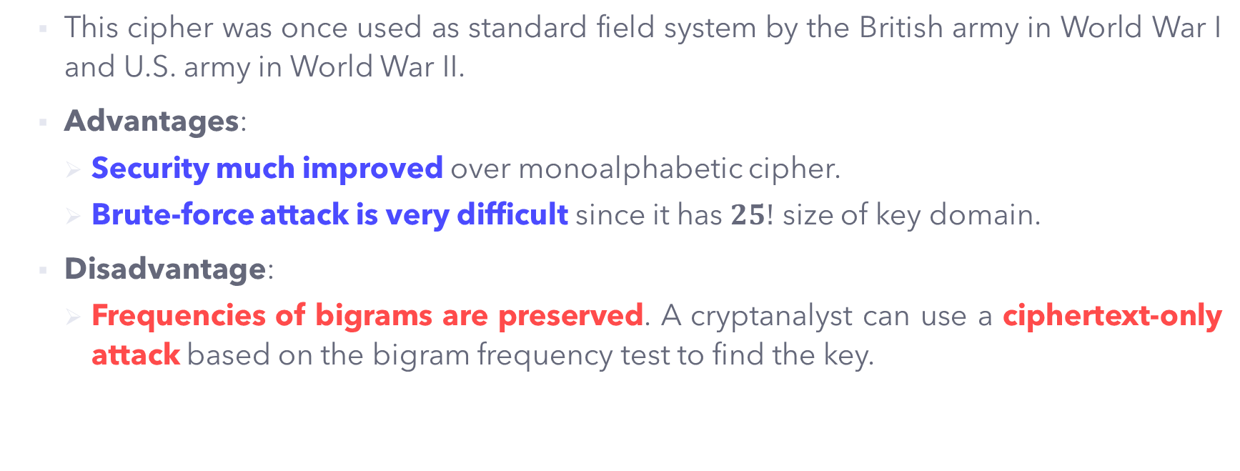
Security on Playfair Cipher
This cipher was once used as standard field system by the British army in World War I and U.S. army in World War II.
Advantages:
Security much improved over monoalphabetic cipher.
Brute-force attack is very difficult since it has $25!$ size of key domain.
Disadvantage:
Frequencies of bigrams are preserved. A cryptanalyst can use a ciphertext-only attack based on the bigram frequency test to find the key.

Slide 51
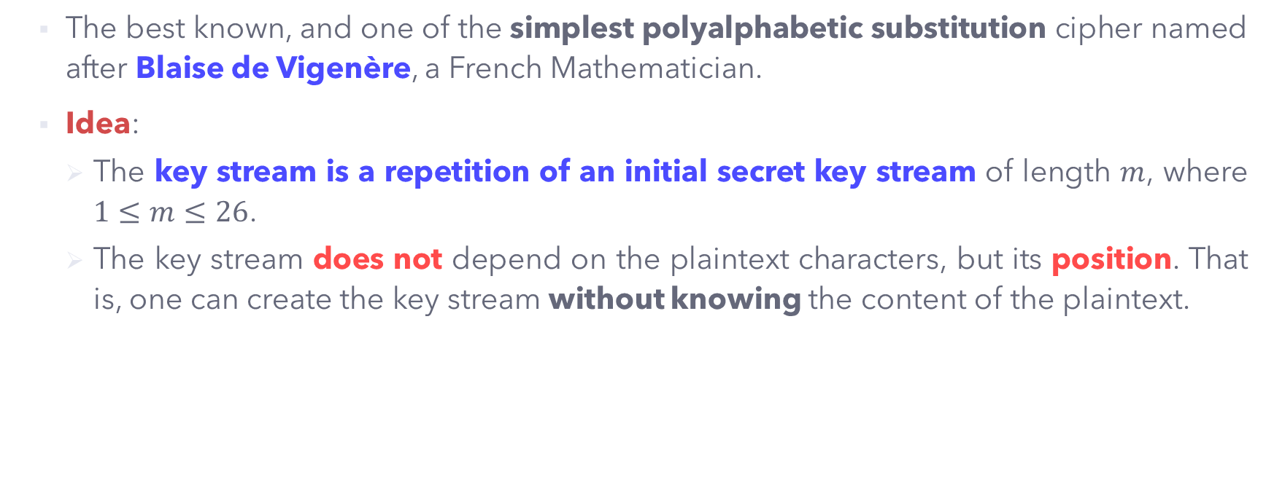
Polyalphabetic Substitution – Vigenère Cipher
The best known, and one of the simplest polyalphabetic substitution cipher named after Blaise de Vigenère, a French Mathematician.
Idea:
The key stream is a repetition of an initial secret key stream of length $m$, where $1≤m≤26$.
The key stream does not depend on the plaintext characters, but its position. That is, one can create the key stream without knowing the content of the plaintext.

Slide 52
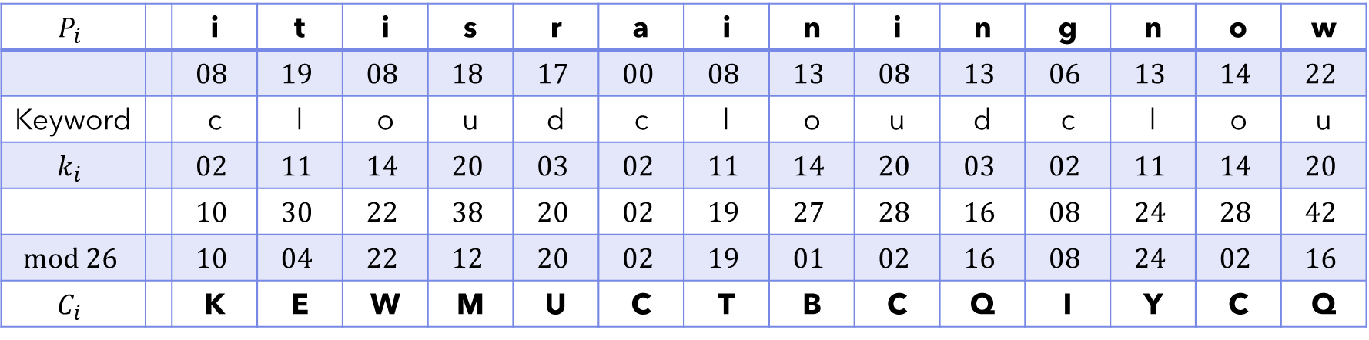
Polyalphabetic Substitution – Vigenère Cipher
Example 10: Perform encryption on the message ‘it is raining now’ using Vigenère cipher with the keyword ‘cloud’.
The produced ciphertext is : KEWMUCTBCQIYCQ.
$$P_{i}$$ |  | i | t | i | s | r | a | i | n | i | n | g | n | o | w
 |  | $$08$$ | $$19$$ | $$08$$ | $$18$$ | $$17$$ | $$00$$ | $$08$$ | $$13$$ | $$08$$ | $$13$$ | $$06$$ | $$13$$ | $$14$$ | $$22$$
Keyword |  | c | l | o | u | d | c | l | o | u | d | c | l | o | u
$$k_{i}$$ |  | $$02$$ | $$11$$ | $$14$$ | $$20$$ | $$03$$ | $$02$$ | $$11$$ | $$14$$ | $$20$$ | $$03$$ | $$02$$ | $$11$$ | $$14$$ | $$20$$
 |  | $$10$$ | $$30$$ | $$22$$ | $$38$$ | $$20$$ | $$02$$ | $$19$$ | $$27$$ | $$28$$ | $$16$$ | $$08$$ | $$24$$ | $$28$$ | $$42$$
$$mod 26$$ |  | $$10$$ | $$04$$ | $$22$$ | $$12$$ | $$20$$ | $$02$$ | $$19$$ | $$01$$ | $$02$$ | $$16$$ | $$08$$ | $$24$$ | $$02$$ | $$16$$
$$C_{i}$$ |  | K | E | W | M | U | C | T | B | C | Q | I | Y | C | Q

Slide 53
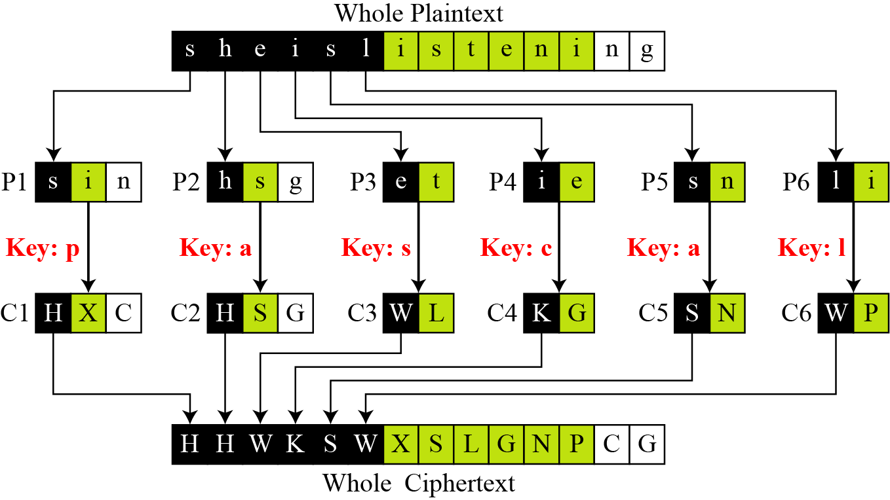

Polyalphabetic Substitution – Vigenère Cipher
In another perspective, we can view the Vigenère cipher as a combination of $m$ additive ciphers, as illustrated below:
(Right) Encryption of the message ‘she is listening’ using the keyword ‘pascal’ that produces ciphertext ‘HHWK SWXS LGNP CG’.

Slide 54
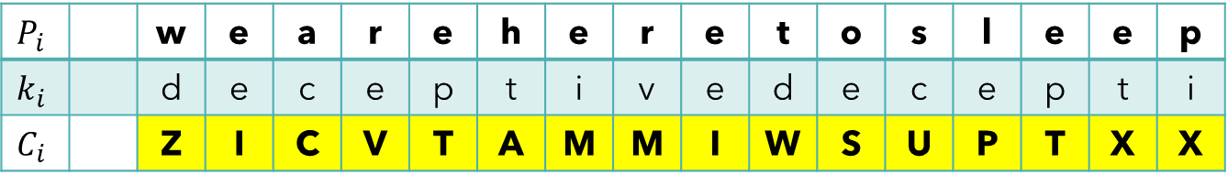
Polyalphabetic Substitution – Vigenère Cipher
Alternatively, we can use a Vigenère tableau (in next slide) to find the output of the encryption.
The top row (small letters) represents the plaintext characters.
The leftmost column (capital letters) represents the keyword.
The remaining entries in the table are the ciphertext characters.
Example: The message ‘we are here to sleep’ is encrypted using the keyword ‘deceptive’. Using the Vigenère tableau:
$$P_{i}$$ |  | w | e | a | r | e | h | e | r | e | t | o | s | l | e | e | p
$$k_{i}$$ |  | d | e | c | e | p | t | i | v | e | d | e | c | e | p | t | i
$$C_{i}$$ |  | Z | I | C | V | T | A | M | M | I | W | S | U | P | T | X | X

Slide 55
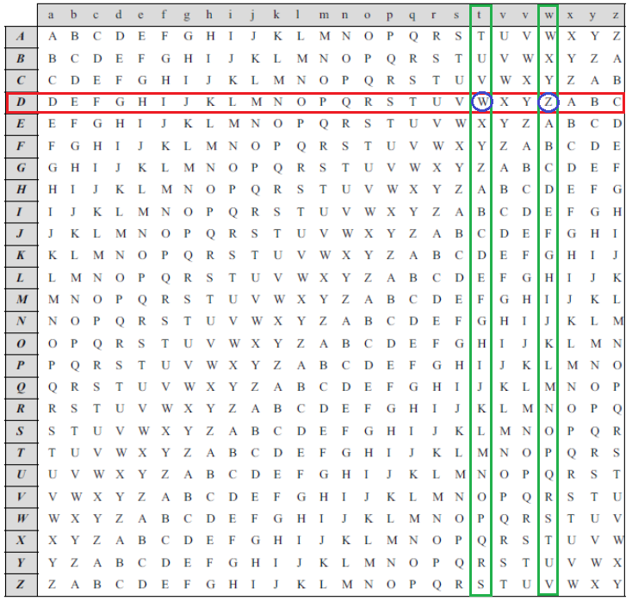

Slide 56
Polyalphabetic Substitution – Vigenère Cipher
Exercise 4: Perform encryption on the message ‘The class is cancelled today’ using Vigenère cipher with the keyword ‘cryptography’.
Solution:
The ciphertext produced is: VYCR EOYJ IHJY PTCA ESJK OSHW.
t | h | e | c | l | a | s | s | i | s | c | a | n | c | e | l | l | e | d | t | o | d | a | y
C | R | Y | P | T | O | G | R | A | P | H | Y | C | R | Y | P | T | O | G | R | A | P | H | Y
V | Y | C | R | E | O | Y | J | I | H | J | Y | P | T | C | A | E | S | J | K | O | S | H | W

Slide 58
Security on Vigenère Cipher
Advantage:
Vigenère cipher does not preserve the frequency of characters, hence the letter frequencies are hidden.
Disadvantage:
The knowledge of the plaintext structure is not lost completely.
Cryptanalysis is still possible via:
Finding the key length. For example, the Kasiski test.
Finding the key.

Slide 59
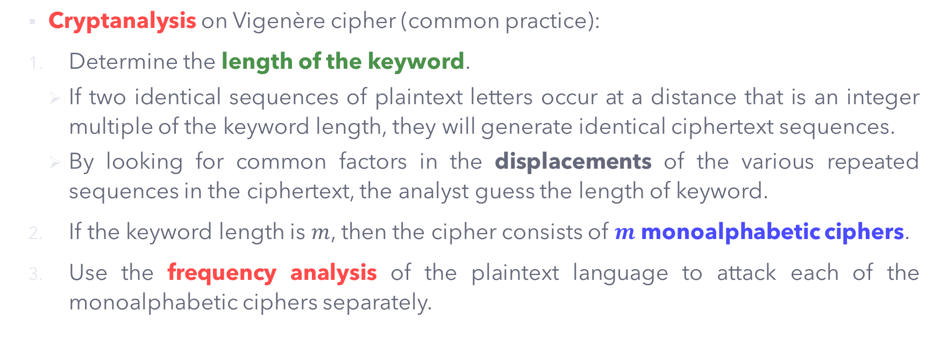
Security on Vigenère Cipher
Cryptanalysis on Vigenère cipher (common practice):
Determine the length of the keyword.
If two identical sequences of plaintext letters occur at a distance that is an integer multiple of the keyword length, they will generate identical ciphertext sequences.
By looking for common factors in the displacements of the various repeated sequences in the ciphertext, the analyst guess the length of keyword.
If the keyword length is $m$, then the cipher consists of $m$ monoalphabetic ciphers.
Use the frequency analysis of the plaintext language to attack each of the monoalphabetic ciphers separately.

Slide 60
Polyalphabetic Substitution – Rotor Cipher
Idea:
It uses the monoalphabetic substitution technique, but changes the mapping between the plaintext characters and the ciphertext characters for each plaintext character.
In other word, after encrypting one plaintext character, the rotor will rotate (according to the pre-defined mapping) and the next encryption for the same plaintext character may NOT necessarily be the same.

Slide 61
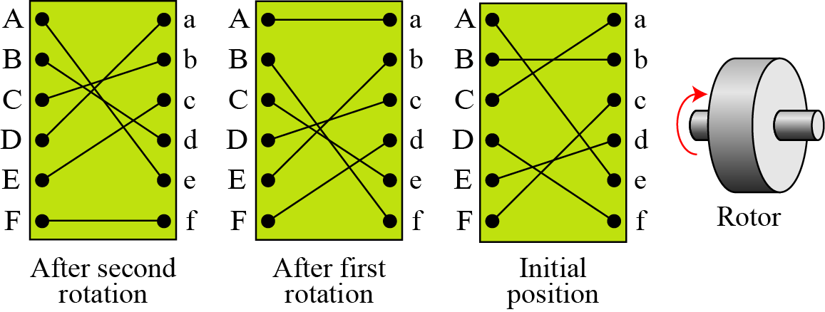
Polyalphabetic Substitution – Rotor Cipher
The example of rotor cipher is shown below. If one encrypts the message ‘deaf’, then the ciphertext produced will be ‘ECDC’. (Do you know why ‘f’ is encrypted to ‘C’?)

Slide 62
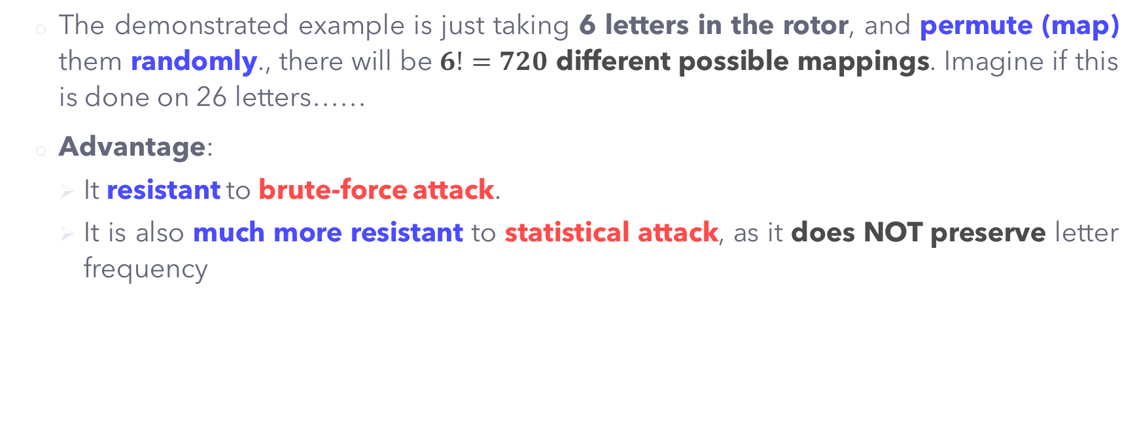
Security on Rotor Cipher
The demonstrated example is just taking 6 letters in the rotor, and permute (map) them randomly., there will be $6!=720$ different possible mappings. Imagine if this is done on 26 letters……
Advantage:
It resistant to brute-force attack.
It is also much more resistant to statistical attack, as it does NOT preserve letter frequency

Slide 63
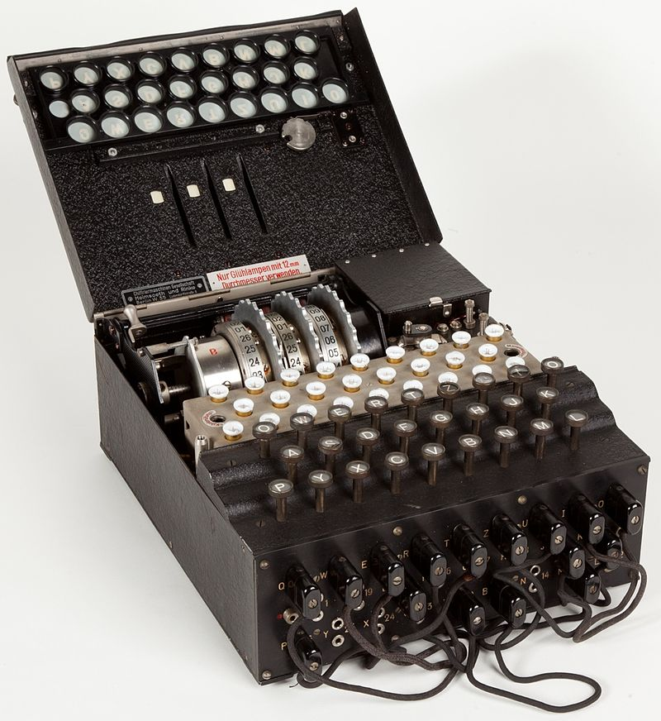
Advancement on Rotor Cipher – the Enigma Machine
The Enigma Machine was designed based on the idea of rotor cipher.
It was originally invented by Sherbius, but later modified by German army and used extensively during the World War II.
The Enigma Machine defeated all the existing cryptography techniques at that time, thought to be very secure.
This machine was broken by Alan Turing, which believed to shorten the WWII by at least 2 years.

Slide 64
Advancement on Rotor Cipher – the Enigma Machine
The right shows the schematic of the Enigma machine.
The complete and detailed procedures can be referred to the main reference book by Forouzan [1], page 79 – 80.

Slide 65
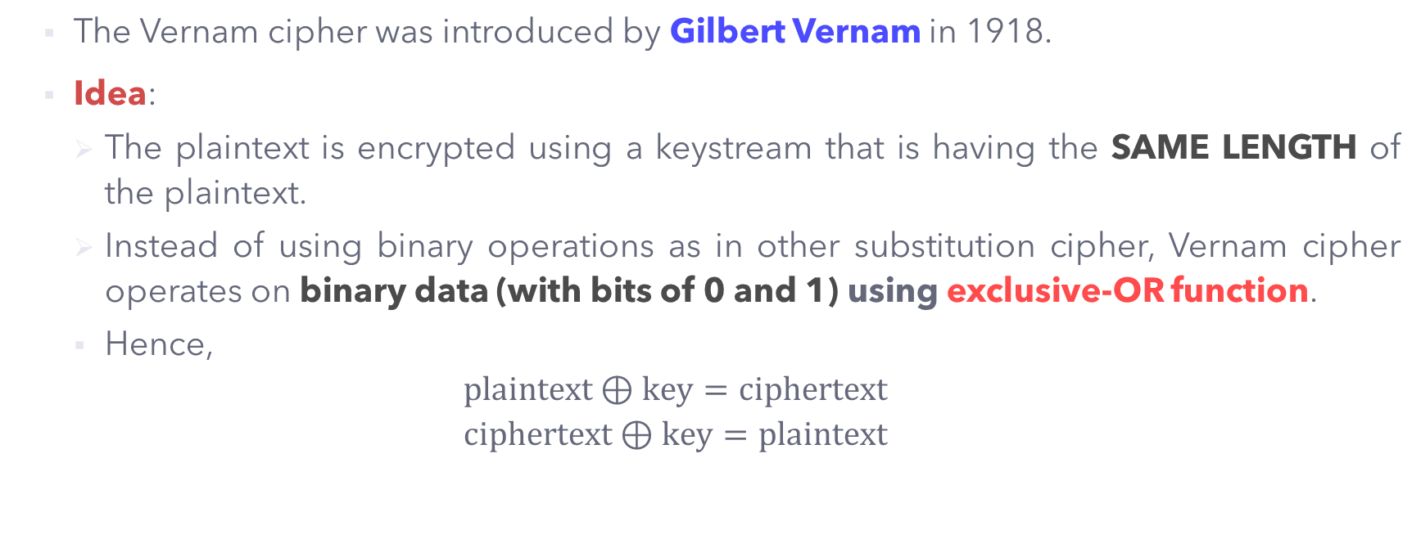
Polyalphabetic Substitution – Vernam Cipher
The Vernam cipher was introduced by Gilbert Vernam in 1918.
Idea:
The plaintext is encrypted using a keystream that is having the SAME LENGTH of the plaintext.
Instead of using binary operations as in other substitution cipher, Vernam cipher operates on binary data (with bits of 0 and 1) using exclusive-OR function.
Hence,
$$plaintext⊕key=ciphertext$$
$$ciphertext⊕key=plaintext$$

Slide 66

Advancement on Vernam Cipher – the One-Time Pad
Advanced from the idea of Vernam cipher, the One-Time Pad is the ONLY cipher that is UNBREAKABLE !!! A perfect cipher with perfect secrecy (wow).
This cipher is encrypted using a completely random chosen key that has the SAME length as the plaintext.
Why not everyone use it,
since it is so perfect, right?

Slide 67
Advancement on Vernam Cipher – the One-Time Pad
Practical issue of the One-Time Pad:
Almost impossible to implement it commercially, since each communication requires a newly generated secret key that is as long as plaintext text.
Producing large quantities of random keys becomes a challenging task.
Distributing and protecting these keys becomes a problem.
Still, it is useful for small-scale implementation such as sending small secret message between you and your friends.

Slide 68
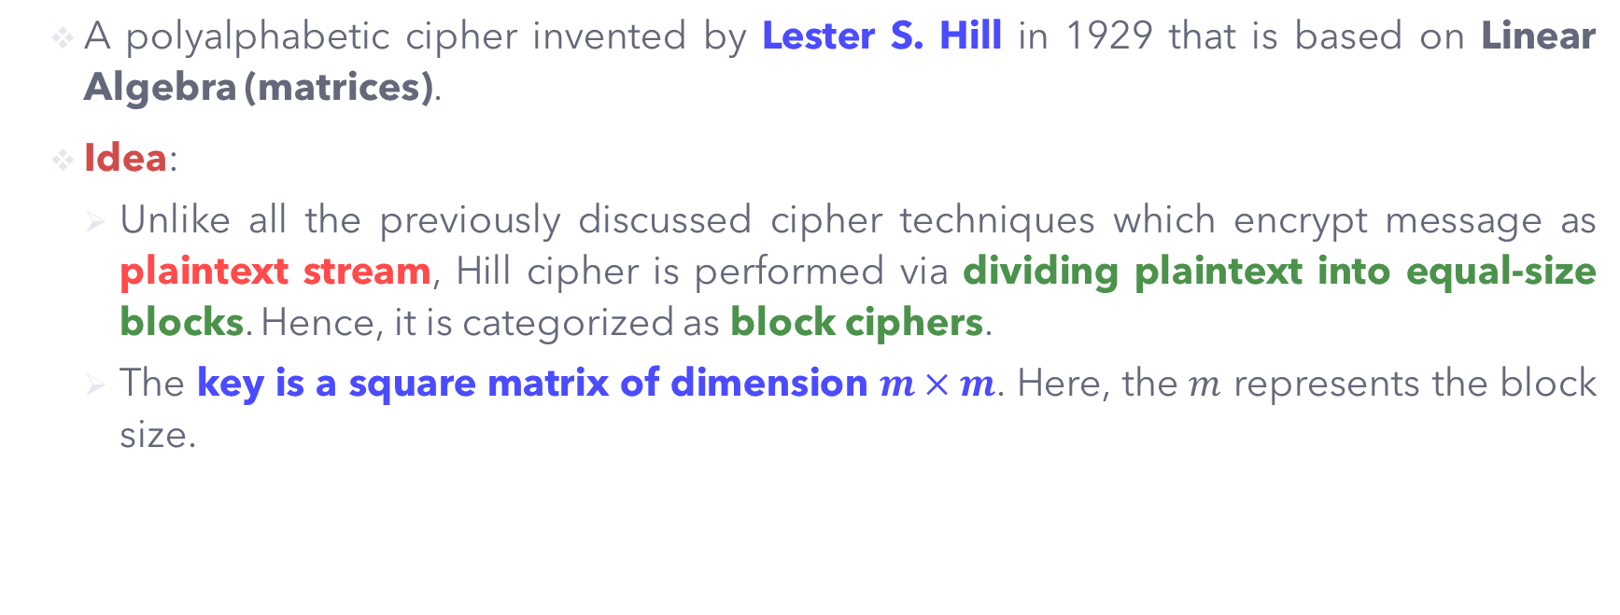
Polyalphabetic Substitution – Hill Cipher (Optional)
A polyalphabetic cipher invented by Lester S. Hill in 1929 that is based on Linear Algebra (matrices).
Idea:
Unlike all the previously discussed cipher techniques which encrypt message as plaintext stream, Hill cipher is performed via dividing plaintext into equal-size blocks. Hence, it is categorized as block ciphers.
The key is a square matrix of dimension $m×m$. Here, the $m$ represents the block size.

Slide 69
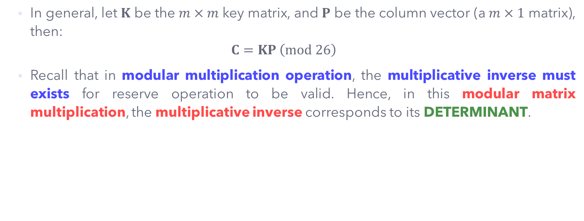
Polyalphabetic Substitution – Hill Cipher (Optional)
In general, let $K$ be the $m×m$ key matrix, and $P$ be the column vector (a $m×1$ matrix), then:
$$C=KP \left(mod 26\right)$$
Recall that in modular multiplication operation, the multiplicative inverse must exists for reserve operation to be valid. Hence, in this modular matrix multiplication, the multiplicative inverse corresponds to its DETERMINANT.

Slide 70
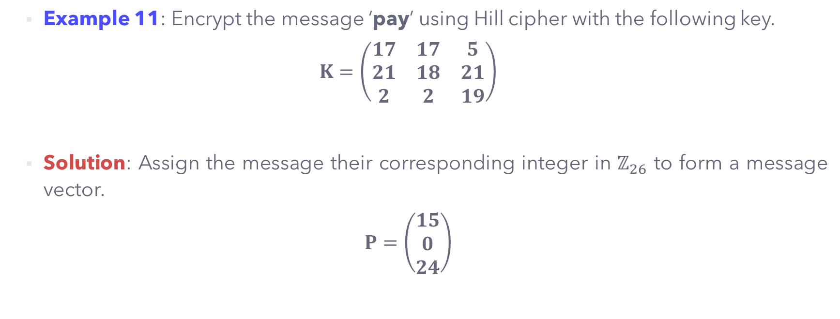
Polyalphabetic Substitution – Hill Cipher (Optional)
Example 11: Encrypt the message ‘pay’ using Hill cipher with the following key.
$$K=\left(\begin{matrix}17 & 17 & 5 \\ 21 & 18 & 21 \\ 2 & 2 & 19\end{matrix}\right)$$
Solution: Assign the message their corresponding integer in $ℤ_{26}$ to form a message vector.
$$P=\left(\begin{matrix}15 \\ 0 \\ 24\end{matrix}\right)$$

Slide 71

Polyalphabetic Substitution – Hill Cipher (Optional)
Then,
$$C=KP \left(mod 26\right)=\left(\begin{matrix}17 & 17 & 5 \\ 21 & 18 & 21 \\ 2 & 2 & 19\end{matrix}\right)\left(\begin{matrix}15 \\ 0 \\ 24\end{matrix}\right)=\left(\begin{matrix}375 \\ 819 \\ 486\end{matrix}\right)=\left(\begin{matrix}11 \\ 13 \\ 18\end{matrix}\right) \left(mod 26\right)$$
The produced ciphertext is: $\left(\begin{matrix}11 \\ 13 \\ 18\end{matrix}\right)=\left(\begin{matrix}L \\ N \\ S\end{matrix}\right)$.

Slide 72
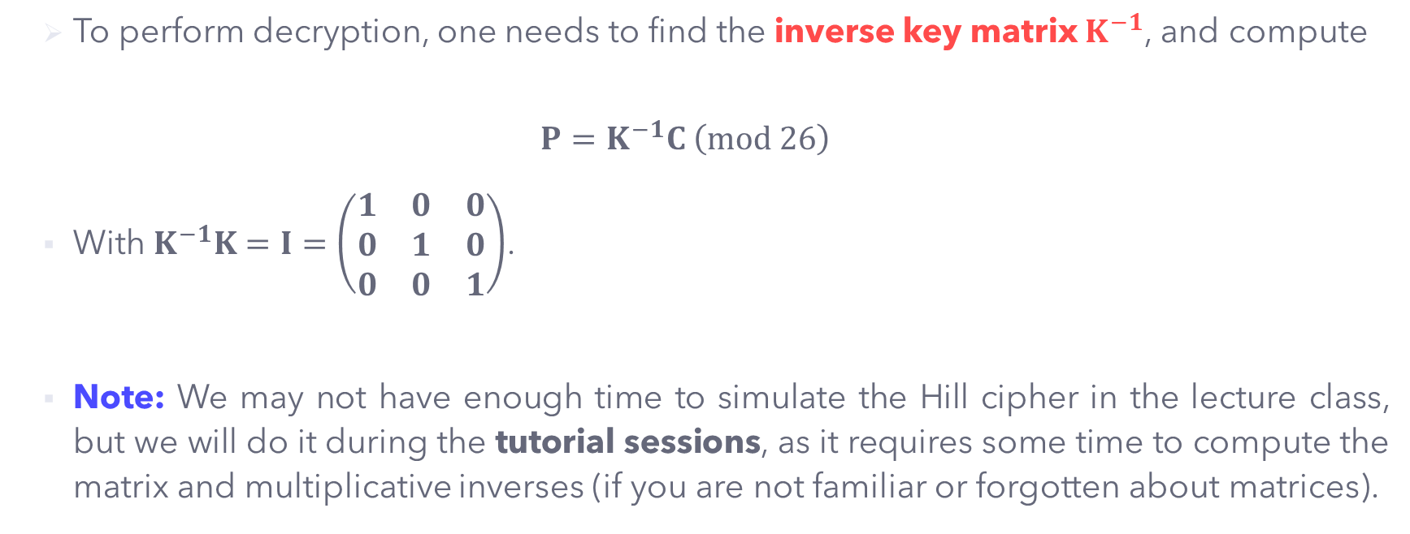
Polyalphabetic Substitution – Hill Cipher (Optional)
To perform decryption, one needs to find the inverse key matrix $K^{−1}$, and compute
$$P=K^{−1}C \left(mod 26\right)$$
With $K^{−1}K=I=\left(\begin{matrix}1 & 0 & 0 \\ 0 & 1 & 0 \\ 0 & 0 & 1\end{matrix}\right)$.
Note: We may not have enough time to simulate the Hill cipher in the lecture class, but we will do it during the tutorial sessions, as it requires some time to compute the matrix and multiplicative inverses (if you are not familiar or forgotten about matrices).

Slide 73
Security on Hill Cipher (Optional)
Advantage:
The Hill cipher hides the single-letter frequency information, therefore survive the frequency analysis.
The larger dimension of key matrix provide higher security level.
Disadvantage:
It is computational more costly since larger dimension of key matrices requires more computational power.

Slide 74
TRANSPOSITION CIPHERS

Slide 75
Transposition Ciphers - Overview
Transposition ciphers does not substitute one symbol for another, instead it changes the location (or position) of the symbols.
In other words, transposition ciphers REORDER (or permute) the symbols without changing its actual (original) symbols.
Transposition ciphers can be further divided into two categories:
Keyless Transposition cipher.
Keyed Transposition cipher.

Slide 76
KEYLESS TRANSPOSITION CIPHERS

Slide 77
Keyless Transposition - Overview
This technique does not required any key in permuting the plaintext characters.
There are generally two approaches in the keyless transposition cipher:
The plaintext characters are arranged column-by-column, and the ciphertext is written row-by-row.
The plaintext characters are arranged row-by-row, and the ciphertext is written column-by-column.

Slide 78
Keyless Transposition – Rail Fence Cipher
The Rail Fence cipher is the example of 1st approach in keyless transposition cipher.
It arranges the plaintext into two lines as a zigzag pattern (column-by-column), and next the corresponding ciphertext is read and written row-by-row.
Example 12: Encrypt the message ‘meet you tonight’ using rail fence cipher.
Solution:
The produced ciphertext is: MEYU OIHE TOTN GT.
m |  | e |  | y |  | u |  | o |  | i |  | h
 | e |  | t |  | o |  | t |  | n |  | g |  | t

Slide 79
Keyless Transposition – Rail Fence Cipher
Plaintext: the weather today is so hot and dry
Depth (Rows): 2
Ciphertext: TEETE TDYSO OADRH WAHRO AISHT NDY
t |  | e |  | e |  | t |  | e |  | t |  | d |  | y |  | s |  | o |  | o |  | a |  | d |  | r
 | h |  | w |  | a |  | h |  | r |  | o |  | a |  | i |  | s |  | h |  | t |  | n |  | d |  | y

Slide 80
Keyless Transposition – Rail Fence Cipher
Plaintext: the weather today is so hot and dry
Depth (Rows): 3
Ciphertext: TEEDS ODHWA HROAI SHTND YETTY OAR
t |  |  |  | e |  |  |  | e |  |  |  | d |  |  |  | s |  |  |  | o |  |  |  | d
 | h |  | w |  | a |  | h |  | r |  | o |  | a |  | i |  | s |  | h |  | t |  | n |  | d |  | y
 |  | e |  |  |  | t |  |  |  | t |  |  |  | y |  |  |  | o |  |  |  | a |  |  |  | r

Slide 81
Keyless Transposition – Rail Fence Cipher
Plaintext: the weather today is so hot and dry
Depth (Rows): 4
Ciphertext: TTDOD HAHOA SHNDE EETYS OARWR ITY
t |  |  |  |  |  | t |  |  |  |  |  | d |  |  |  |  |  | o |  |  |  |  |  | d
 | h |  |  |  | a |  | h |  |  |  | o |  | a |  |  |  | s |  | h |  |  |  | n |  | d
 |  | e |  | e |  |  |  | e |  | t |  |  |  | y |  | s |  |  |  | o |  | a |  |  |  | r
 |  |  | w |  |  |  |  |  | r |  |  |  |  |  | i |  |  |  |  |  | t |  |  |  |  |  | y

Slide 82
Keyless Transposition Cipher
Consider the same Example 12, we now encrypt this message using the 2nd approach in keyless transposition cipher (see right).
Here, the plaintext message ‘meet you tonight’ is arranged row-by-row first, next the ciphertext is written column-by- column.
The produced ciphertext is: MYOH EONT EUIT TG.
Note: The number of columns is upon personal preferences. For a longer plaintext message, one may consider adding more columns.
m | e | e | t
y | o | u | t
o | n | i | g
h | t

Slide 83
Keyless Transposition Cipher
Plaintext: the weather today is so hot and dry
Columns: 5
Ciphertext: TATIOD HTOSTR EHDSAY WEAONX ERYHDZ
t | h | e | w | e
a | t | h | e | r
t | o | d | a | y
i | s | s | o | h
o | t | a | n | d
d | r | y | x | z

Slide 84
Keyless Transposition Cipher
Plaintext: the weather today is so hot and dry
Columns: 6
Ciphertext: TTDOD HHAHD EEYOR WRITY ETSAX AOSNZ
t | h | e | w | e | a
t | h | e | r | t | o
d | a | y | i | s | s
o | h | o | t | a | n
d | d | r | y | x | z

Slide 85
Keyless Transposition Cipher
Plaintext: the weather today is so hot and dry
Columns: 7
Ciphertext: THYT HEIA ERSN WTSD WOOD ADHR TAOY
t | h | e | w | e | a | t
h | e | r | t | o | d | a
y | i | s | s | o | h | o
t | a | n | d | d | r | y

Slide 86
Security on Keyless Transposition Cipher
The permutation of the keyless transposition cipher is done on the whole plaintext message to create whole ciphertext.
As no key is involved in the keyless transposition cipher, it is very vulnerable to many cryptanalytic attacks, especially ciphertext-only attack.
One may even to able to guess whether keyless transposition cipher has been used based on the ciphertext itself only. (Logically do you know why?)

Slide 87
KEYED TRANSPOSITION CIPHERS

Slide 88
Keyed Transposition Ciphers
In keyed transposition cipher, the plaintext is split into blocks of pre-determined fixed size.
The permutation is then performed upon these blocks of plaintext using a key. This key determines the permutations of the plaintext characters in each block.

Slide 89
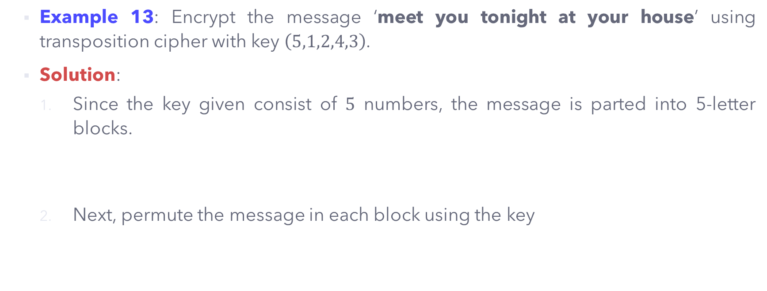
Keyed Transposition Ciphers
Example 13: Encrypt the message ‘meet you tonight at your house’ using transposition cipher with key $\left(5,1,2,4,3\right)$.
Solution:
Since the key given consist of $5$ numbers, the message is parted into 5-letter blocks.
Next, permute the message in each block using the key
m | e | e | t | y
o | u | t | o | n
i | g | h | t | a
t | y | o | u | r
h | o | u | s | e
Y | M | E | T | E
N | O | U | O | T
A | I | G | T | H
R | T | Y | U | O
E | H | O | S | U

Slide 90
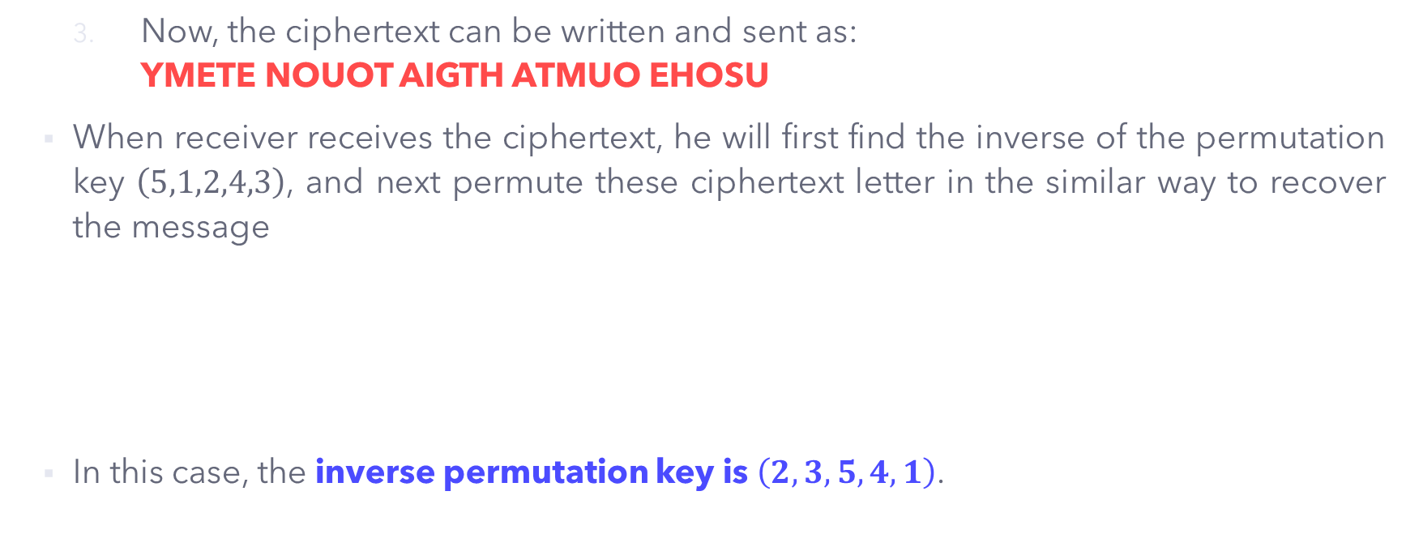
Keyed Transposition Ciphers
Now, the ciphertext can be written and sent as: YMETE NOUOT AIGTH ATMUO EHOSU
When receiver receives the ciphertext, he will first find the inverse of the permutation key $\left(5,1,2,4,3\right)$, and next permute these ciphertext letter in the similar way to recover the message
In this case, the inverse permutation key is $\left(2,3,5,4,1\right)$.
Encryption
Order
5 | 1 | 2 | 4 | 3
1 | 2 | 3 | 4 | 5
Decryption
Order

Slide 91

Keyed Transposition Ciphers
Example 14: Encrypt the message ‘meet you tonight at your house’ using transposition cipher with key $\left(6,2,5,1,3,4\right)$.
Solution:
Since the key given consist of $6$ numbers, the message is parted into 6-letter blocks.
Next, permute the message in each block using the key
m | e | e | t | y | o
u | t | o | n | i | g
h | t | a | t | y | o
u | r | h | o | u | s
e | x | z | x | z | x
O | E | Y | M | E | T
G | T | I | U | O | N
O | T | Y | H | A | T
S | R | U | U | H | O
X | X | Z | E | Z | X

Slide 92

Keyed Transposition Ciphers
Now, the ciphertext can be written and sent as: OEYMET GTIUON OTYHAT SRUUHO XXZEZX
When receiver receives the ciphertext, he will first find the inverse of the permutation key $\left(6,2,5,1,3,4\right)$, and next permute these ciphertext letter in the similar way to recover the message
In this case, the inverse permutation key is
Encryption
Order
6 | 2 | 5 | 1 | 3 | 4
1 | 2 | 3 | 4 | 5 | 6
Decryption
Order

Slide 93

Keyed Transposition Ciphers
Now, the ciphertext can be written and sent as: OEYMET GTIUON OTYHAT SRUUHO XXZEZX
When receiver receives the ciphertext, he will first find the inverse of the permutation key $\left(6,2,5,1,3,4\right)$, and next permute these ciphertext letter in the similar way to recover the message
In this case, the inverse permutation key is $\left(4,2,5,6,3,1\right)$.
Encryption
Order
6 | 2 | 5 | 1 | 3 | 4
1 | 2 | 3 | 4 | 5 | 6
Decryption
Order

Slide 94
KEYLESS + KEYED TRANSPOSITION CIPHERS (Columnar Transposition Ciphers)

Slide 95
Keyless + Keyed Transposition Cipher
To increase the security of the transposition cipher, both keyless and keyed approaches are used instead of one.
The encryption process is done in three (3) steps:
The plaintext is written into a table row-by-row. The number of columns is dependent on the permutation key used. If there is any remaining blank entry in the table, pad it with some random letters (usually ‘x’ or ‘z’).
Permutation is done by reordering the columns.
The permuted ciphertext table is read column-by-column.

Slide 96

Keyless + Keyed Transposition Cipher
Example 15: Using the same plaintext ‘meet you tonight at your house’ and key $\left(5,1,2,4,3\right)$in Example 13. Perform the encryption using the combination of keyless and keyed transposition cipher.
Solution: Refer to the three steps given in the previous slides.
The produced ciphertext is: YNARE MOITH EUGYO TOTUS ETHOU
1 | 2 | 3 | 4 | 5
m | e | e | t | y
o | u | t | o | n
i | g | h | t | a
t | y | o | u | r
h | o | u | s | e
5 | 1 | 2 | 4 | 3
y | m | e | t | e
n | o | u | o | t
a | i | g | t | h
r | t | y | u | o
e | h | o | s | u

Slide 97
Keyless + Keyed Transposition Cipher
To decrypt the ciphertext using this combined approach, we reverse the 3 steps:
The permuted ciphertext is written into a table column-by-column.
Permutation is inverted by reordering the columns using the inverted permutation key.
The plaintext table is read row-by-row.

Slide 98
Security on Transposition Cipher
Transposition cipher DOES NOT change the letter frequency in the ciphertext, it only REORDERS the letters. Hence, it is vulnerable to frequency analysis (statistical attack).
Since the plaintext is written into a table, an attacker could guess the key-length (number of columns) used in the ciphertext, this leads to brute-force attack. This attack is easier for a shorter-length plaintext.
Pattern attack: Some ciphertext may reveal some repeated patterns, resulting attack able to guess the number of columns used in the keyed transposition cipher.
Security enhancement: Double transposition cipher. The same process is repeated for the 1st output ciphertext to generate 2nd ciphertext.

Slide 99

Keyless + Keyed Transposition Cipher
Using the same plaintext ‘meet you tonight at your house’ and key $\left(5,1,2,4,3\right)$. The following is the output of the FIRST encryption.
Ciphertext: YNARE MOITH EUGYO TOTUS ETHOU
1 | 2 | 3 | 4 | 5
m | e | e | t | y
o | u | t | o | n
i | g | h | t | a
t | y | o | u | r
h | o | u | s | e
5 | 1 | 2 | 4 | 3
y | m | e | t | e
n | o | u | o | t
a | i | g | t | h
r | t | y | u | o
e | h | o | s | u

Slide 100

Keyless + Keyed Transposition Cipher
Now, we perform SECOND stage of Columnar Transposition Cipher, using the same permutation key $\left(5,1,2,4,3\right)$
From 1st encryption : YNARE MOITH EUGYO TOTUS ETHOU
Ciphertext:
1 | 2 | 3 | 4 | 5
5 | 1 | 2 | 4 | 3

Slide 101

Keyless + Keyed Transposition Cipher
Now, we perform SECOND stage of Columnar Transposition Cipher, using the same permutation key $\left(5,1,2,4,3\right)$
Ciphertext: EHOSU YMETE NOUOT RTYUO AIGTH
1 | 2 | 3 | 4 | 5
y | n | a | r | e
m | o | i | t | h
e | u | g | y | o
t | o | t | u | s
e | t | h | o | u
5 | 1 | 2 | 4 | 3
e | y | n | r | a
h | m | o | t | i
o | e | u | y | g
s | t | o | u | t
u | e | t | o | h

Slide 102
PRODUCT CIPHERS

Slide 103
Product Cipher - Overview
Ciphers using substitutions or transpositions are not secure because of language characteristics.
Hence, product cipher uses several ciphers in succession or combination to make the ciphertext harder to cryptanalyze.
Examples:
Two substitutions make a more complex substitution.
Two transpositions make a more complex transposition.
A substitution followed by a transposition makes a new much secure cipher.

Slide 104
Main References for Chapter 3
Forouzan, B.A. “Introduction to Cryptography and Network Security”, Third Edition, McGraw-Hill, 2008.
Stallings, W. “Cryptography and Network Security: Principles and Practices”, Fifth Edition, Pearson Prentice Hall, 2011.

Slide 105
~ THE END ☺ ~

Slide 106


Keyless Transposition – Rail Fence Cipher
FLYILDODENTPLULFLEPTOSOSIL

Slide 107

Keyless Transposition – Rail Fence Cipher
FLYILDODENTPLULFLEPTOSOSIL

Slide 108

Keyless Transposition – Rail Fence Cipher
FLYILDODENTPLULFLEPTOSOSIL

Slide 109

WUEA IXBA PYRS NHSR PSTS BHRT OAFL
STTB AIUS OUHA FHIZ EIOI ITHT ARNZ

Slide 110



